Slide 1

Threads
PASS
CS532: OS Foundations
Lab Assignment
Mail id: faiyaz@pdx.edu
Partners mail id: boyapati@pdx.edu

Slide 2
Instructions: Make a copy of this document, move your copy to your submissions folder and fill the document with your responses. Use the space on each slide to show your responses, and add additional slides as needed.
When ready for grading: complete the lab assignment submission form and include a link to your filled document

Slide 3
sum.c
Your assignment is to read, understand, build, run and improve the sum.c program. Begin by reading and understanding the sum.c source code which is linked from the course plan document.
Next, build and run the original sum.c program as described in the source code. When you run the original version it should fail!

Slide 4
1. Why does the original sum program fail? What is wrong with it?
Answer: The original sum program fails when the threads are declared and used in functions and then there is no synchronization in the threads. Since all the threads tries to access the same variables, this leads to wrong results.

Slide 5
2. Modify the sum.c source code to create a new version named sum2.c that calculates the sums correctly and consistently using multiple threads. Test sum2 with 4 threads and various numbers of Rounds such as 2, 20, 200, 2000. Keep the code INEFFICIENT in that every thread updates the global Total on every iteration of its inner loop. If your code takes longer than 2 minutes to run, then stop it and run with a lower number of Rounds.
Upload your sum2.c file to your submissions folder and provide a link to it here:- https://drive.google.com/file/d/18ZlOgDlGon1Of-5Dz9JGxQ4Aff4Kio0E/view?usp=share_link

Slide 6
3. Improve your sum2.c source code to produce a new version, called sum3.c, that is more efficient in that each thread calculates its local sum and then modifies the shared Total variable when finished calculating its local total.
Build, Run, Test and Upload sum3.c to your submissions folder and provide a link to it here:
https://drive.google.com/file/d/159yppIW2Bgm7NqyK070ZWWhbancc-Q36/view?usp=share_link
Code looks good

Slide 7
4. Compare the performance of your sum2 vs. sum3 using 4 threads and each of these values for the "Rounds" input: 500, 1000, 2000, 4000, 8000. Construct a line graph comparing the runtime of sum2 vs. sum3 for each Rounds input value. Show your graph on the next page.
(btw, one easy way to measure the runtime of a program on Linux is to run it with the time command like this: time <my command> )

Slide 8
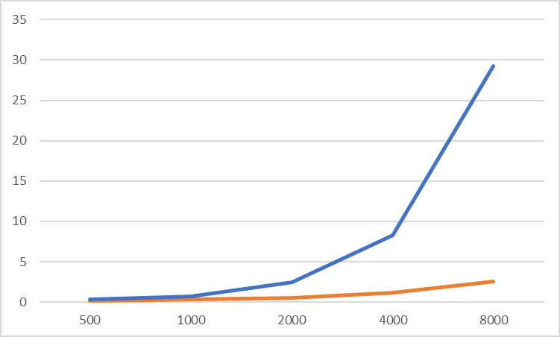
Runtime Comparison of sum2 vs. sum3
Rounds | 500 | 1000 | 2000 | 4000 | 8000
sum2 | 0.19 | 0.39 | 1.866 | 7.099 | 26.683
sum3 | 0.171 | 0.306 | 0.561 | 1.21 | 2.587
Orange line - sum3
Blue line - sum2

Slide 9
5. What conclusions/observations do you make about the two fixed versions, sum2 and sum3?
Answer: From the data from previous slide, we can say sum3 performs better when compared to sum2. When the no.of rounds are less sum2 and sum3 performance is almost the same. But when the no of rounds increased sum3 performed than sum2.

